Slide 1

Object – Oriented Programming
Iksan Bukhori, M.Phil.

Slide 2
Topic 5: Inheritance

Slide 3
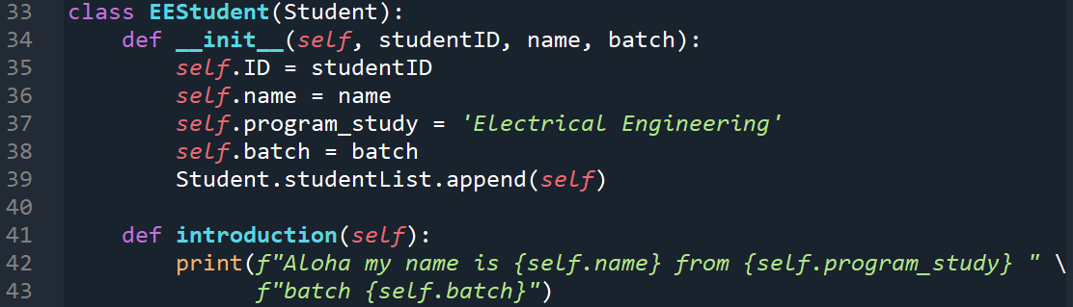
EEStudent Class as Child Class of Student
Say that we want to create another class for EE Students. We can do this through inheritance
Pay attention to line 33 where the name of the parent class is put as parameter of the child class header

Slide 4
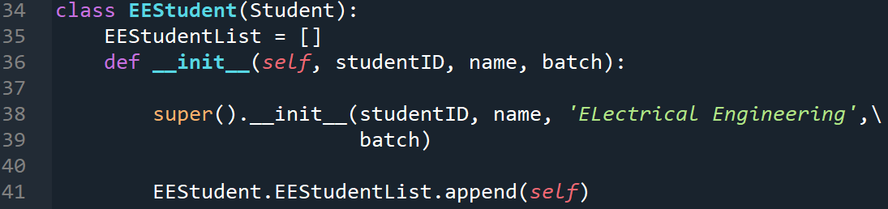
Super() function
We can simplify the constructor in child class using super()
Pay attention to line 38 where we call the constructor of parent class using super()
This also makes it unnecessary to have line 39 on the previous slide

Slide 5
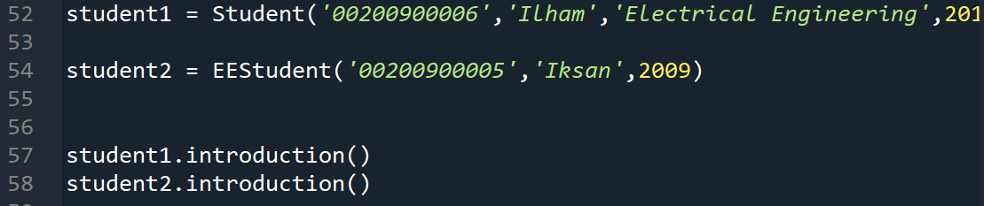
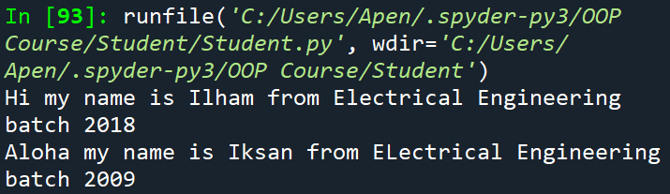
Child vs Parent Access
Try to access method introduction from the instance of the Parent class and the instance of the Child class
Since there is no introduction() method in EEStudent class, python will look for a method of that name from the parent class, i.e. Student class

Slide 6
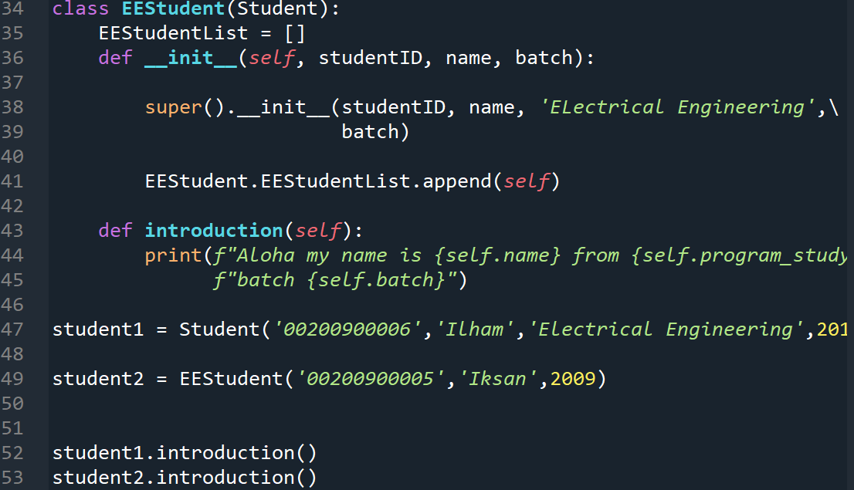
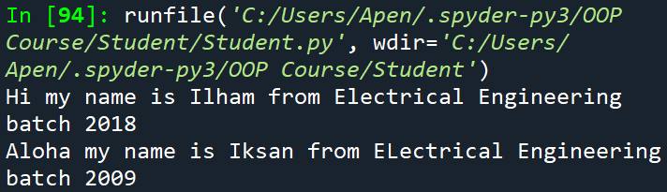
Method Overriding
Try to add implementation of introduction() method for EEStudent and call the method from both Student and EEStudent again
Since there is introduction() method in EEStudent class, python will execute this method instead of the method of the same name in Student Class
Here, we say introduction() method in EEStudent overrides introduction() method in Student

Slide 7
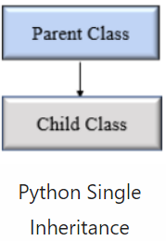
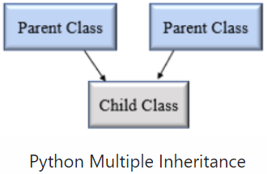
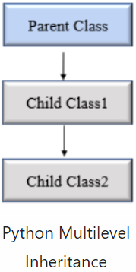
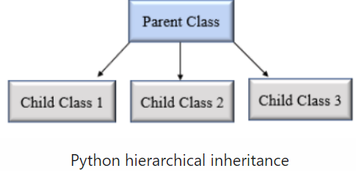
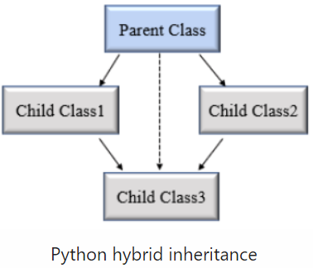
Different Types of Inheritance Hierarchy
Source: https://pynative.com/python-inheritance/

